Slide 1
Annual Partnership Programme

Slide 2
Who are ISPA?
Founded in 1995, the Internet Services Providers’ Association (ISPA) represents over 200 providers of Internet services in the UK and provides essential support through innovation, knowledge and experience in order to benefit the UK economy and society.
ISPA Members include:

Slide 3
Current Issues
Cyber Security
Broadband Rollout
Business broadband
Age-verification
Data protection
Investigatory Powers Act
Consumer Green Paper
Universal Service Obligation

Slide 4
Why Partner with ISPA?
The ISPA Annual Sponsorship Programme will provide you with comprehensive and ongoing marketing opportunities over a 12 month period to enhance your brand exposure to over 200 leading ISPs and other stakeholders.
Demonstrate your knowledge and expertise by inputting into ISPA events
Have a ready made sponsorship and marketing plan for your business
Position your company as a true industry leader and strategic partner for the future
Make new and valuable business contacts that you can nurture all year round
Help support the important work that ISPA does to advance the ISP industry
Gain invaluable industry insight and help shape ISPA’s agenda
Boost sales opportunities by getting in front of your target audience
Differentiate yourself from competitors in a crowded market

Slide 5
Why Partner with ISPA?
The ISPA Annual Sponsorship Programme will provide you with comprehensive and ongoing marketing opportunities over a 12 month period to enhance your brand exposure to over 200 leading ISPs and other stakeholders.
Demonstrate your knowledge and expertise by inputting into ISPA events
Have a ready made sponsorship and marketing plan for your business
Position your company as a true industry leader and strategic partner for the future
Make new and valuable business contacts that you can nurture all year round
Help support the important work that ISPA does to advance the ISP industry
Gain invaluable industry insight and help shape ISPA’s agenda
Boost sales opportunities by getting in front of your target audience
Differentiate yourself from competitors in a crowded market
Notes:
Same content as slide 4, formatted differently

Slide 6
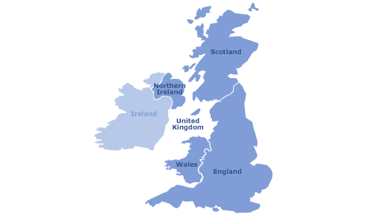
Facts and Figures at a glance
1,500 readership of ISPA's monthly newsletter
ISPA membership is large & varied and covers the breadth of the U.K
Tier 1
SME
B2B
Managed Service
FTTx
Wireless
satellite
2,850 Twitter followers
Industry figures who attend ISPA events:
CEOs
Senior regulatory specialists
Head of Policy
Directors: Business development, Customer service, Marketing, Procurement

Slide 7
How it works?
Your partnership with ISPA is based on 12 months of continuous benefits and opportunities
Customise your sponsorship to meet your objectives and get the most value for your budget – all year long
You have the opportunity to select the standard ISPA Partnership package and add on upgrades according to where you would like to focus.
Starting with membership, additional benefits include policy conferences, an awards ceremony and more.

Slide 8
ISPA ANNUAL PARTNERSHIP PACKAGE
£7000+VAT
Editorials in the ISPA monthly newsletter
Annual ISPA membership
Sponsor an award at the prestigious ISPA Awards 2018
Your company featured on the ISPA website
Lead and shape a workshop with members in your subject of expertise
Featured at all ISPA events

Slide 9
ISPA Event Sponsorship Packages
ISPA AWARDS
Be a HEADLINE SPONSOR
Host the Drinks and Networking reception at the ISPA Awards
only £3000 +VAT
with the ISPA Annual Partnership Package
P&I CONFERENCE
Be a HEADLINE SPONSOR
ISPA CONFERENCE
Be a HEADLINE SPONSOR
Choose to do a keynote address or participate in panel sessions and input on major themes
only £3000 + VAT
Choose to do a keynote address or participate in panel sessions and input on major themes
from £3000 + VAT with the ISPA Annual Partnership Package
with the ISPA Annual Partnership Package

Slide 10
ISPA Membership
Access to industry insight via policy mailing lists and the opportunity to shape ISPA policy
Access to the ISPA Monitor (a weekly email with updates on political and regulatory developments, news and upcoming events)
Participation in working groups, including Broadband, Liability & Safety and Cybersecurity
Invitations to ISPA’s event programme, with the opportunity to speak, network and contribute
Welcome announcement in the monthly ISPA Newsletter sent to over 1500 contacts and opportunities to provide content
Regular networking opportunities with ISPA members at events and working groups
Use of the ISPA logo, a recognised symbol of trust, and your company details on the website

Slide 11
ISPA Awards
The ISPA Awards is the leading independent internet industry awards in the UK. The event celebrates and rewards the best providers in the sector with awards for broadband, hosting, cyber-security, VoIP, cloud and more.
Get your company in front of over 300 senior figures from across the UK Internet industry.
Your sponsorship would include these elements plus more!
Headline Sponsor credits on promotional mailouts and marketing materials
Logo and URL link on sponsors page of awards website
10 Tickets to the event including a 3 course meal, wine and entertainment (worth £2500)
Logo credits on screen and stage branding at the event
Advert on a prominent page in the event programme
Mention in the press release and on Twitter
Exclusive sponsorship in your sector

Slide 12
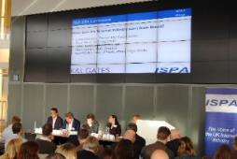
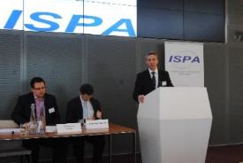
ISPA Conference
Your sponsorship would include:
Sponsor credits on promotional mailouts and marketing materials
Logo and URL link on sponsors page of Conference website
Tickets to the event
Logo credits on screen
Advert in the event programme
Editorial in monthly newsletter
Marketing literature in delegate packs
View of the delegate list ahead of the event and assisted introductions with prospective customers
ISPA’s largest and most high profile policy event, with over 100 delegates gaining market insight as well analysing and debating the pressing regulatory, legal, policy and technological issues.
Option 1: Sponsor the lunch and refreshments
Option 2: Branded panel sponsorship
Option 3: Keynote speaking slot during the day

Slide 13
Parliament & Internet Conference
The Parliament & Internet conference has up to 200 delegates each year from Government, Parliament, Whitehall, industry and civil society. The event has a range of panel sessions, presentations, and workshops to encourage focused discussion of key industry issues
Your sponsorship could include:
Ten minute keynote address – aligned with keynote Government speaking slot (where timings are possible)
Option to work with organisers to plan major themes
Participation in a panel session of your choice with input into the theme and lead introduction to the session
Option to participate in another panel session if relevant
Logo to be displayed on all promotional communication relating to the Conference and on the website
Display of marketing material at the event
Option to send information in follow up communication to attendees
Social Media and press engagement

Slide 14
Contact ISPA to find out more
If you would like to partner with ISPA, or discuss the options in more detail, you can contact us via email or phone
admin@ISPA.org.uk
Speak to Andrew on 020 3397 3304

